Slide 1

Music Generation with Neural Network Models
By: David Castillo

Slide 2
Problem Statement
As a data scientist for a Record Company that utilizes music samples, personnel in accounting are worried about the exponentially increasing expenses with clearing samples for artists beats. They are wondering if a model can generate new music from existing jazz and classical works. In order to have a bigger collection from which to sample from in house, we can then scale up and create sounds with other genres. This could really help the finances of the business as we could be decreasing those expenditures that result in clearing samples. We can define success in part by the objective measure of minimizing value loss when creating these models. Another factor to take into account is how this music is perceived and we can use some objective criteria for that as well such as rhythm, or patterns of notes that sound dynamic.

Slide 3

Background Research

Slide 4

Music
The art of music
Debatable origins
Significant cultural pillar

Slide 5

Music Theory and Mathematics
Music has a deep relationship with mathematics.
Discrete whole numbers are used for labeling pitches/keys
Helps with pattern recognition
We perceive pitch as a relative value , we perceive ratio between frequencies.

Slide 6

The dataset
301 midi files scraped from https://bushgrafts.com/midi/.
295 midi files downloaded from https://www.kaggle.com/soumikrakshit/classical-music-midi
Additionally over 400 piano midi files were obtained from a personal collection.
Processed via music21 library.

Slide 7
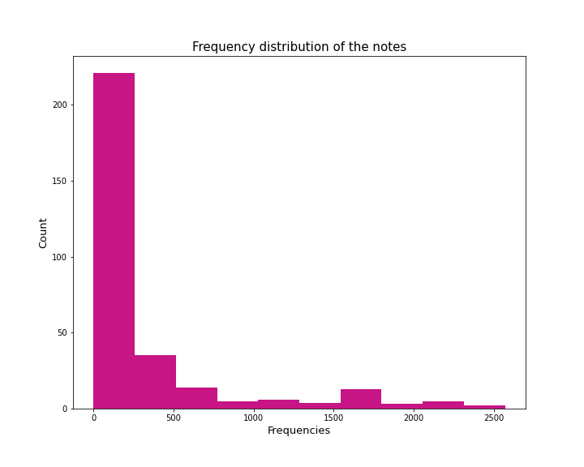
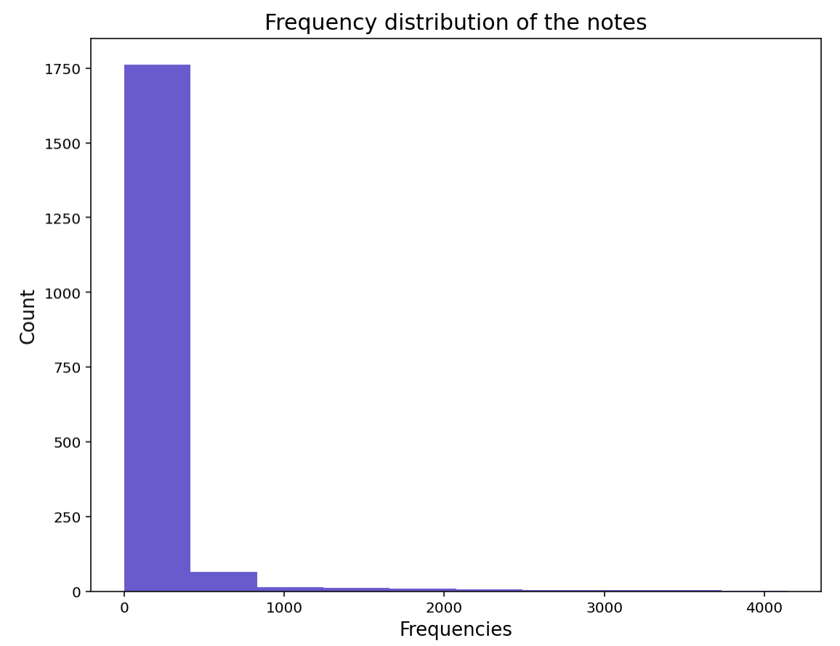

Slide 8
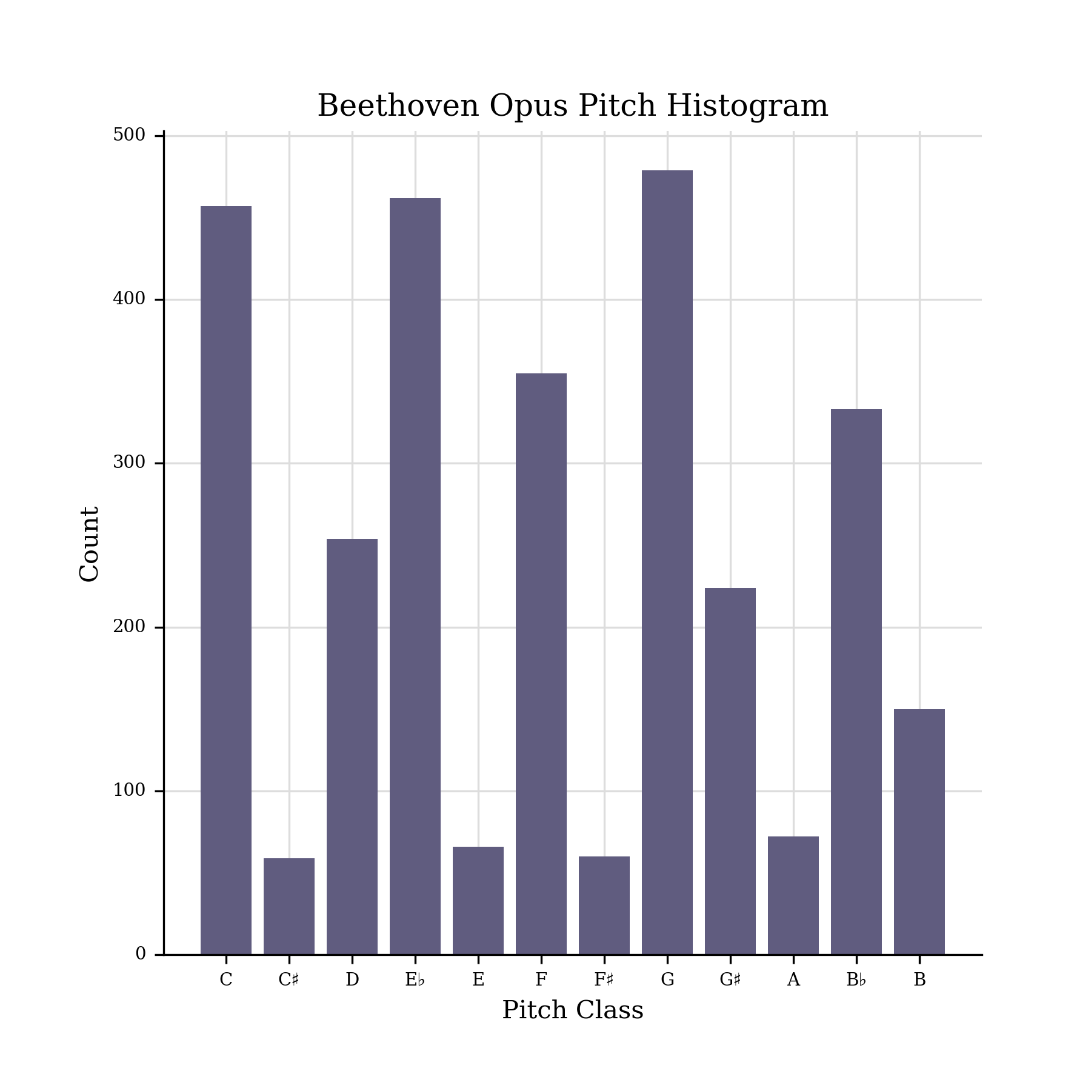
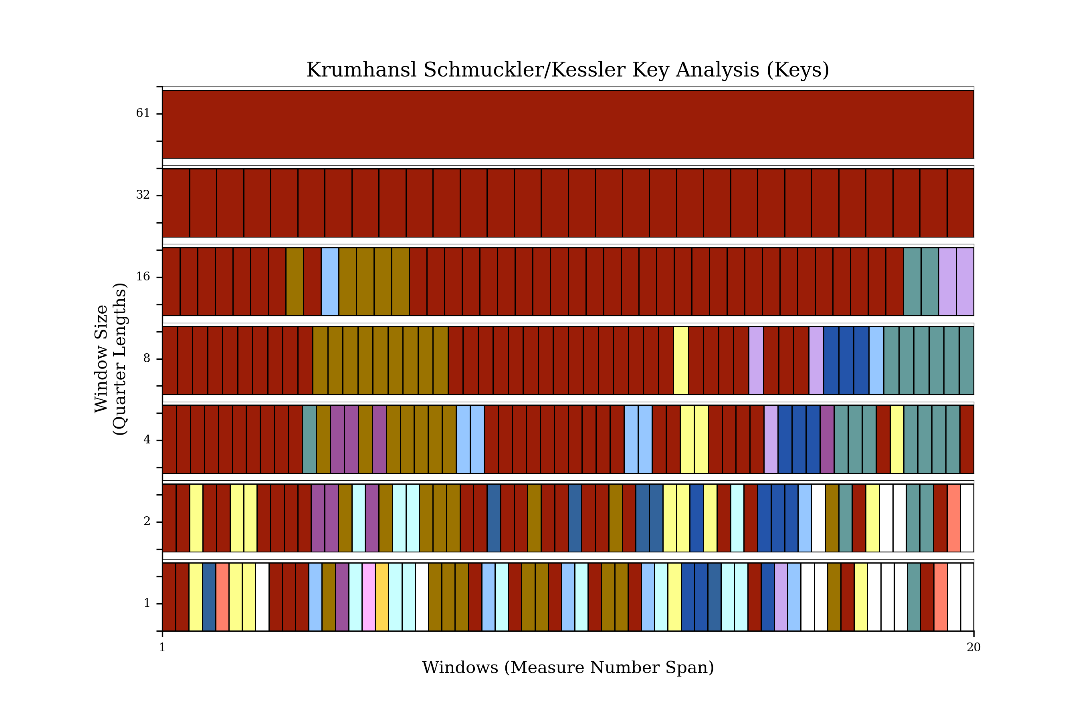
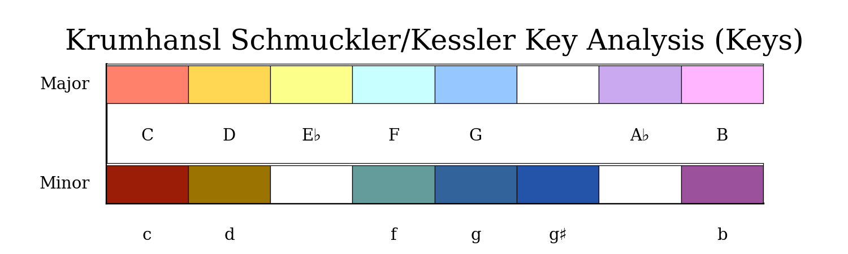

Slide 9
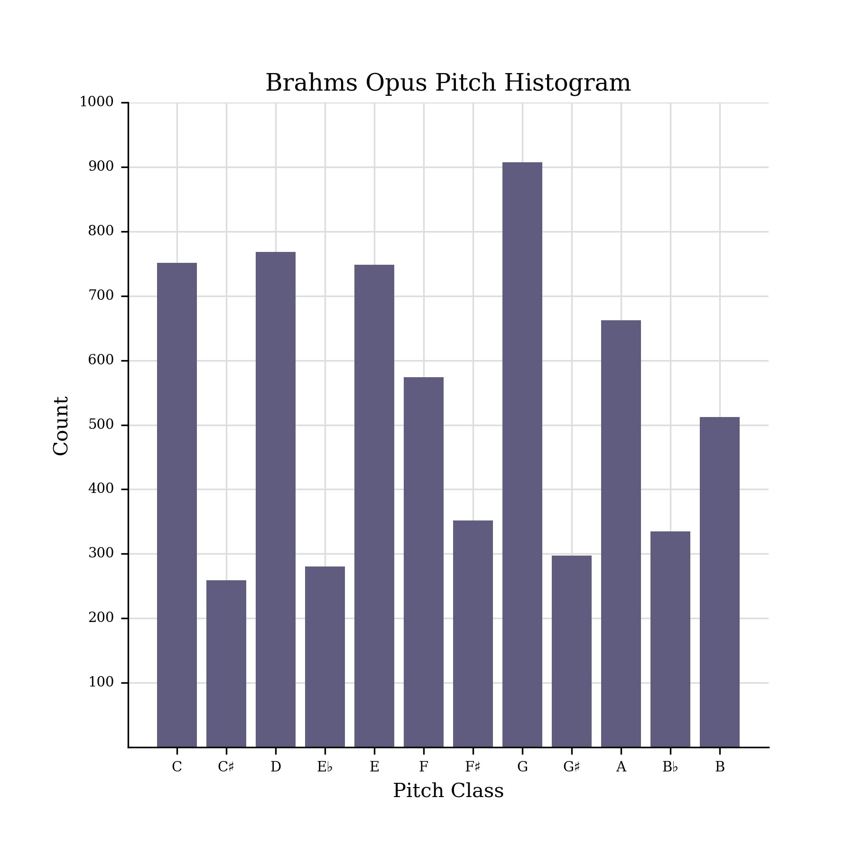
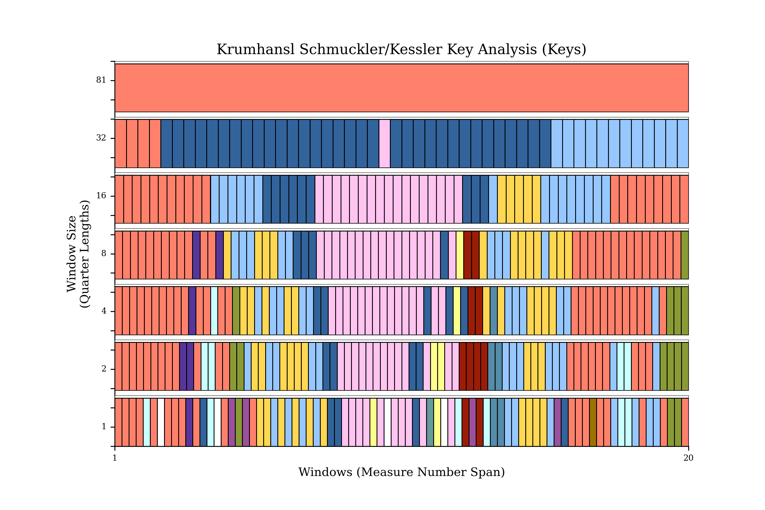
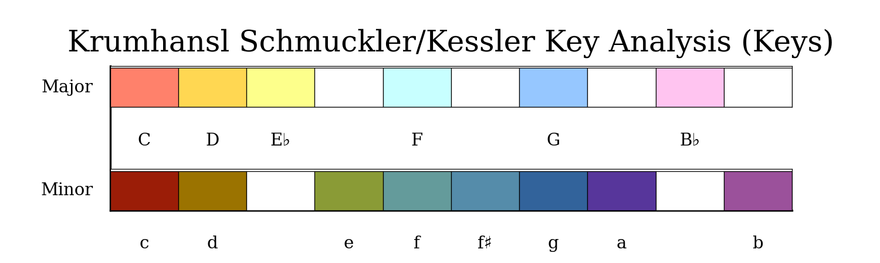

Slide 10
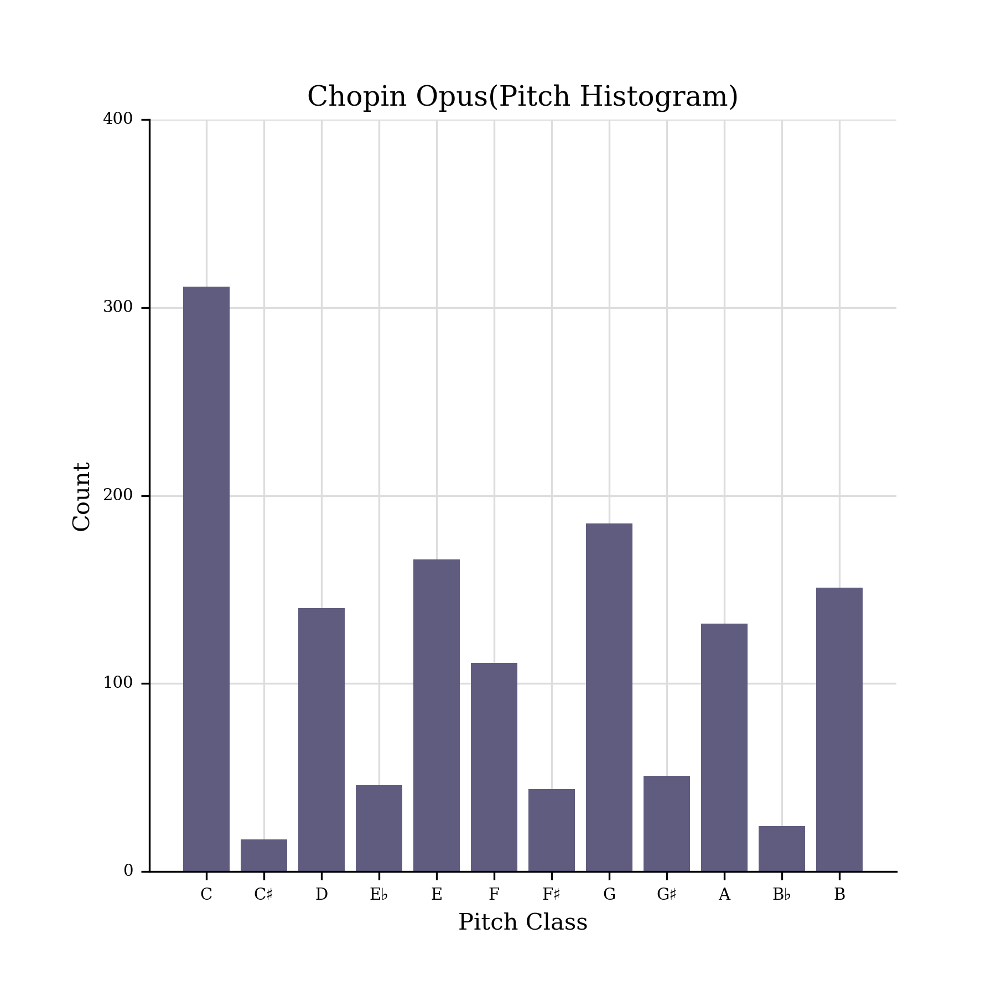
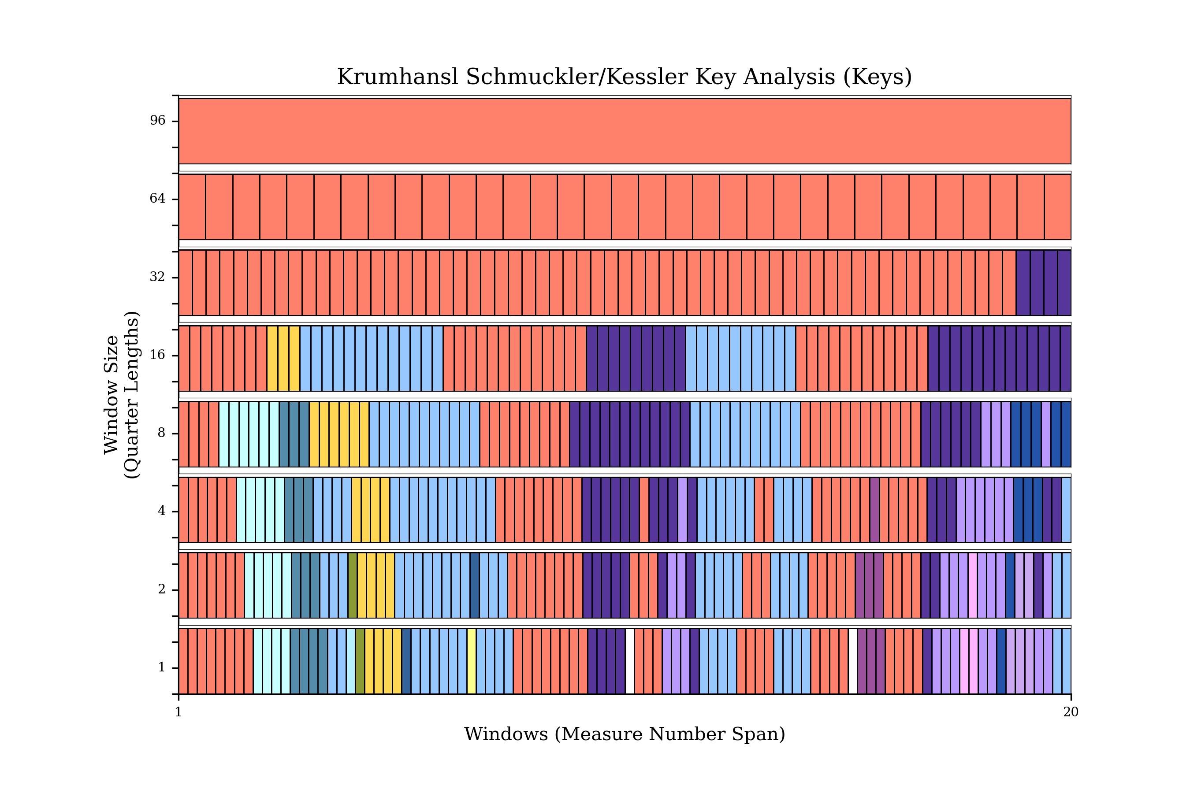
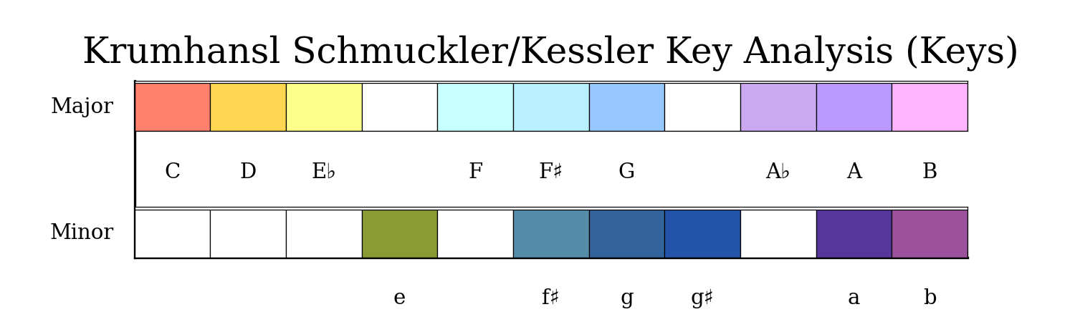

Slide 11
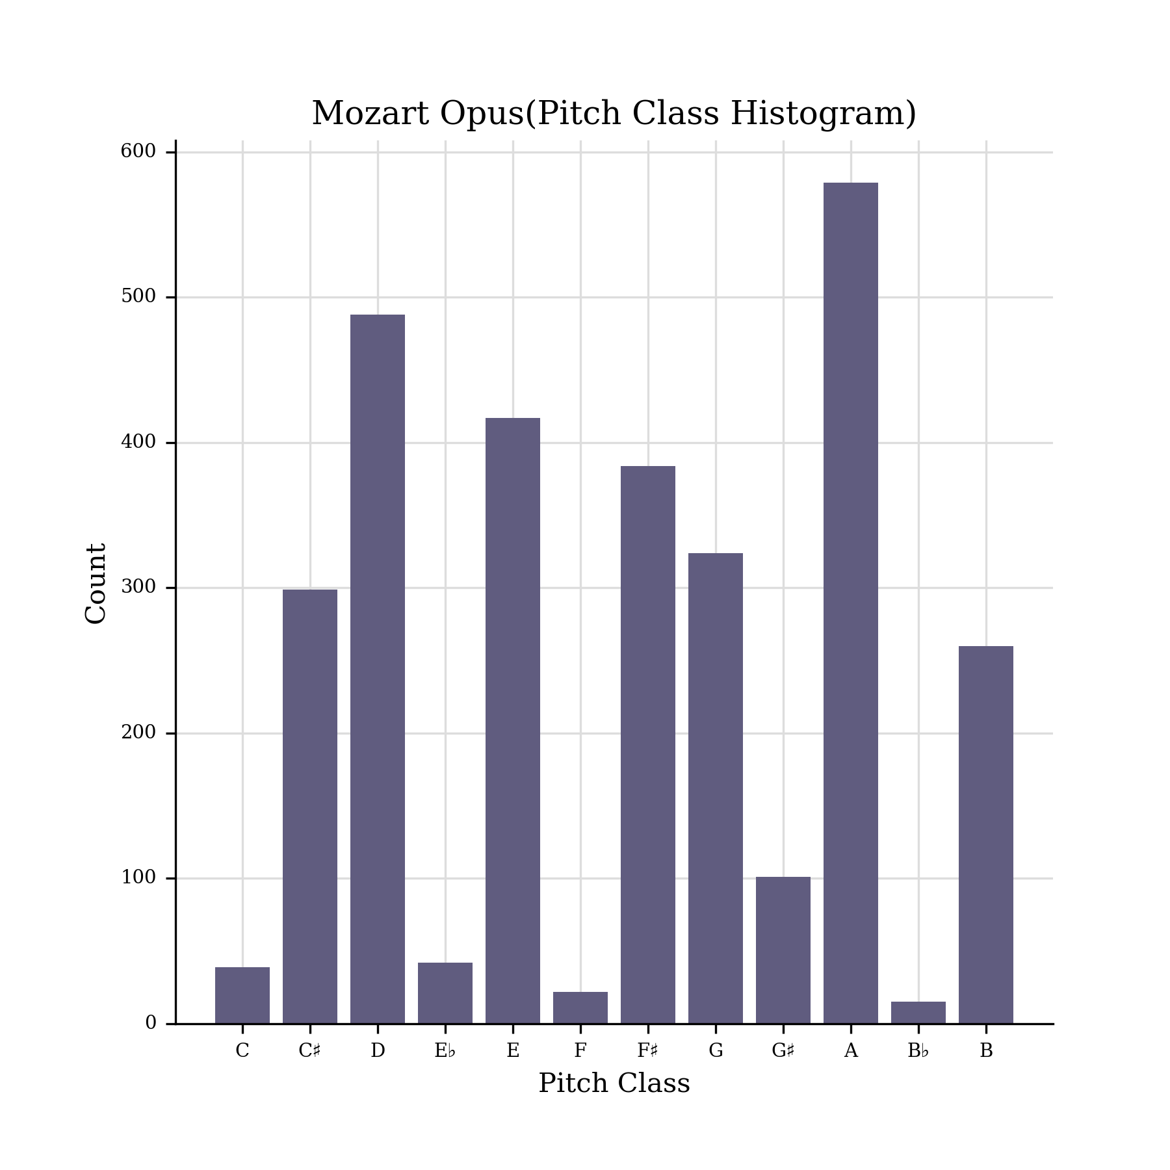
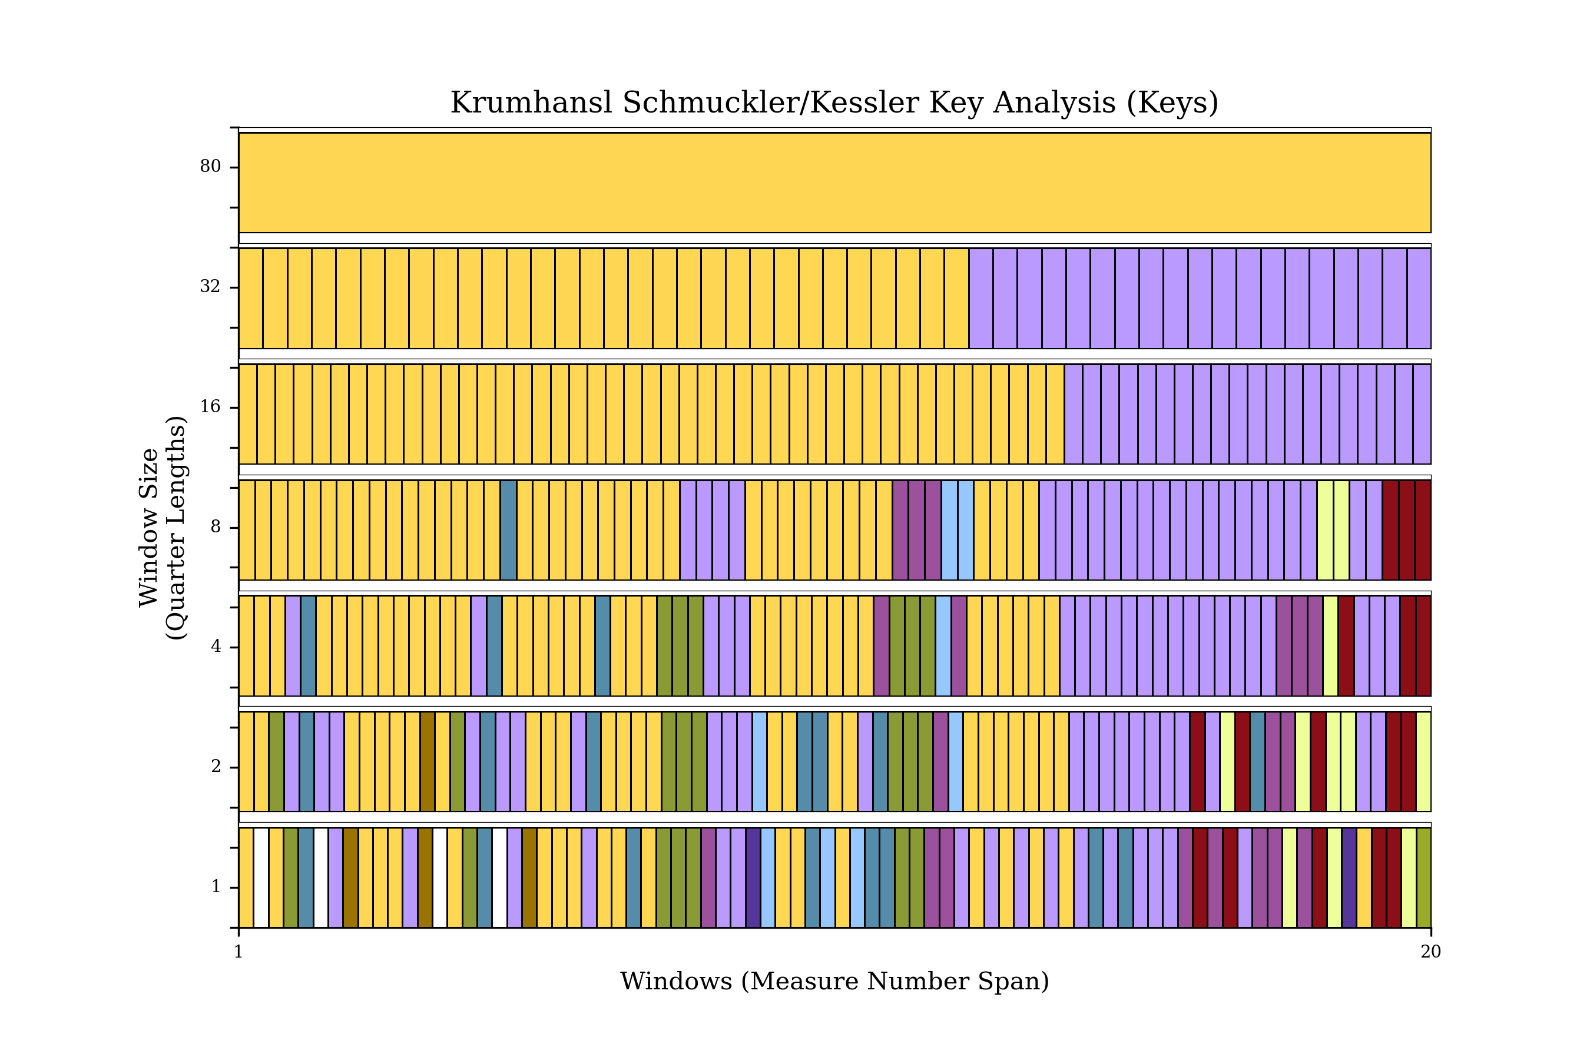
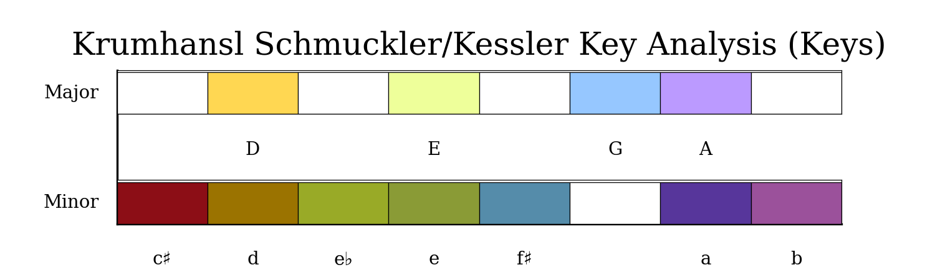

Slide 12

Modeling Approach
Music 21
CNN model(Wave net)
RNN model(LSTM)

Slide 13

Wavenet models
This Photo by Unknown Author is licensed under CC BY

Slide 14
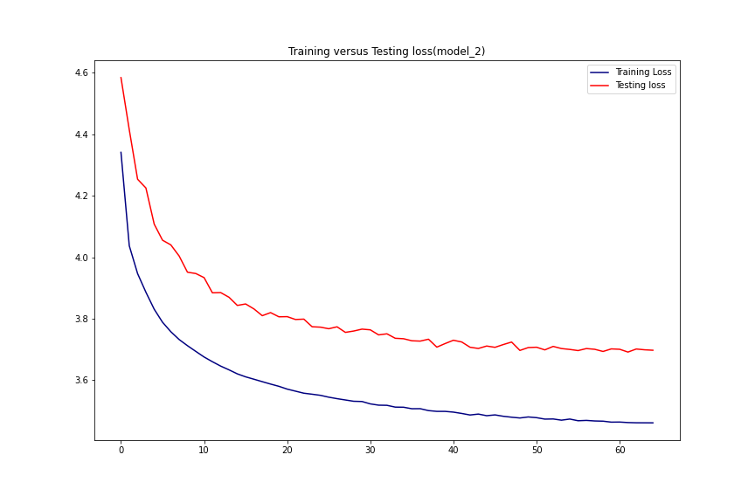
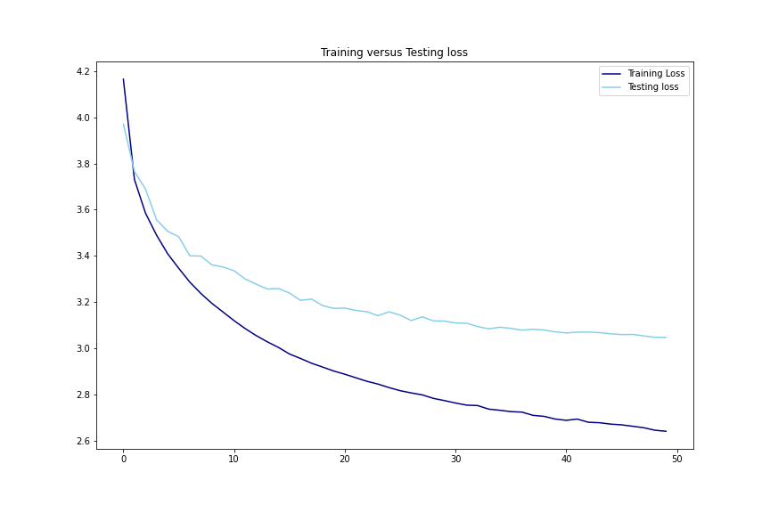

Slide 15
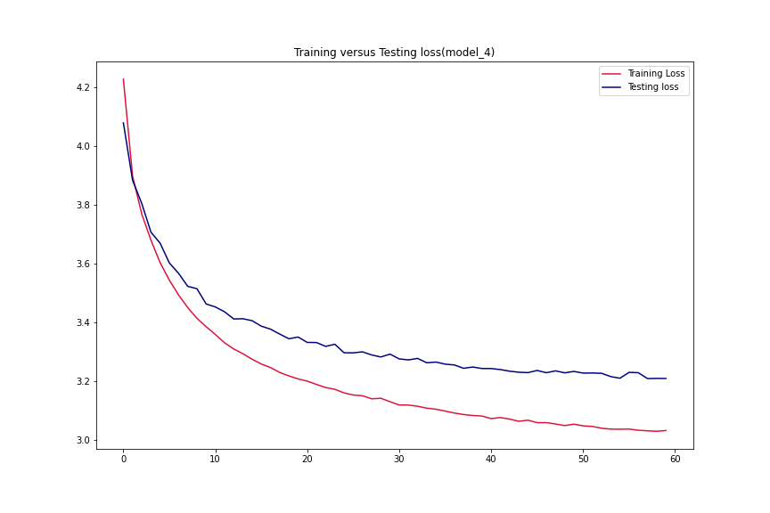
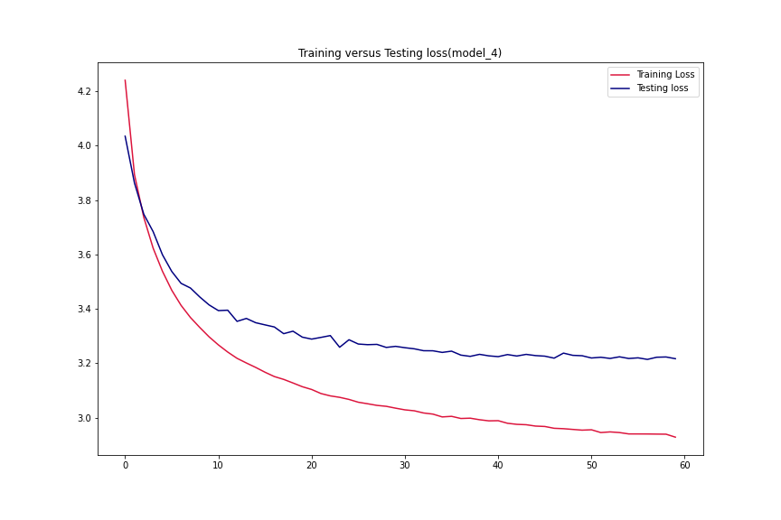

Slide 16

LSTM models

Slide 17
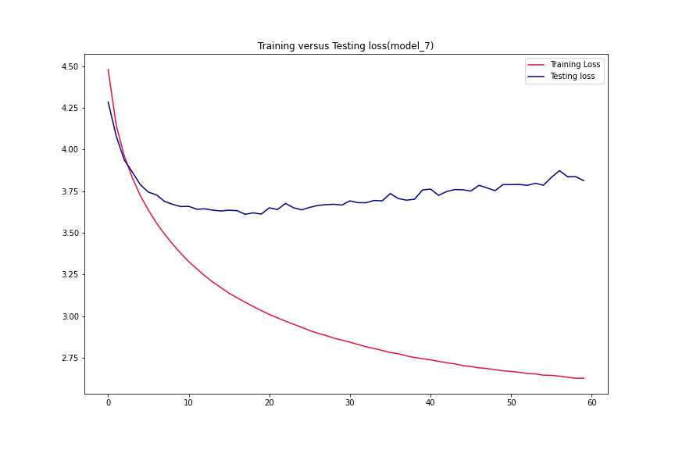
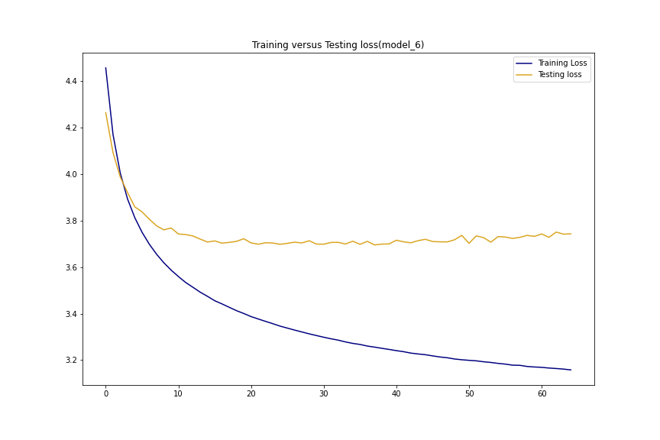

Slide 18
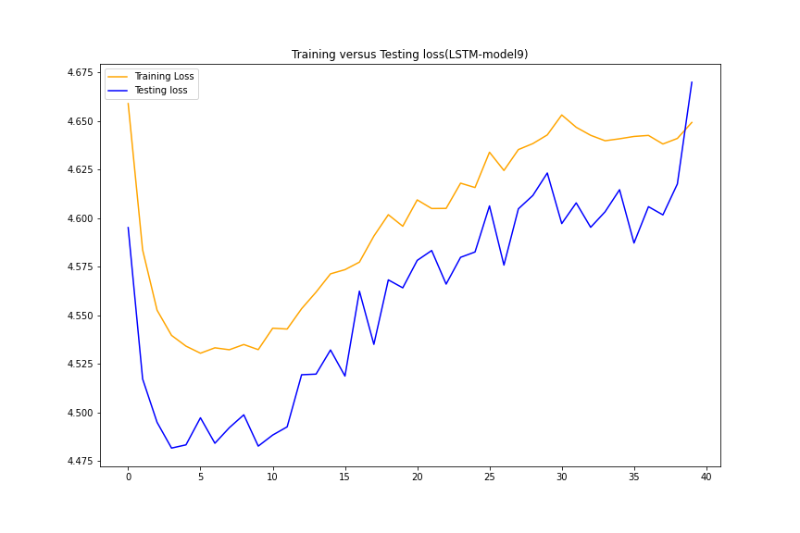
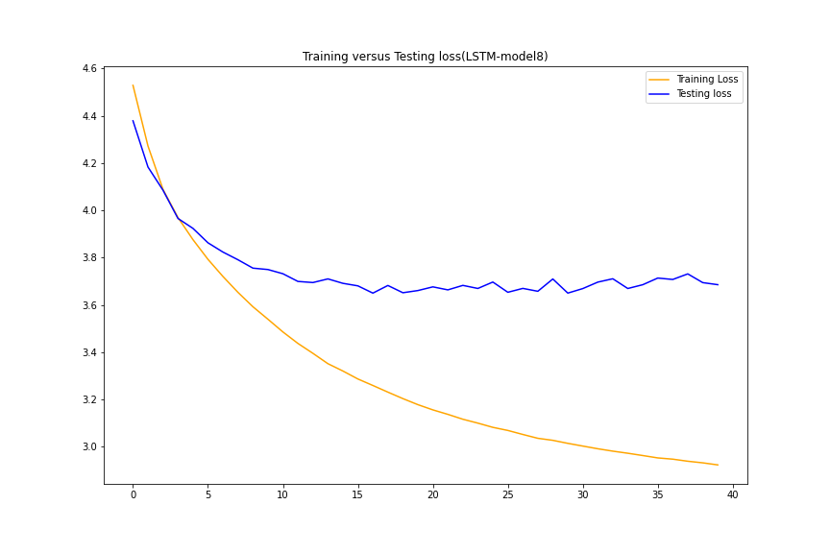

Slide 19
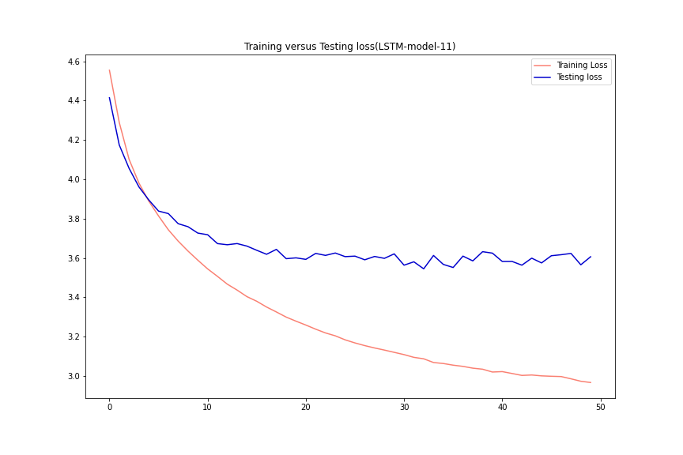
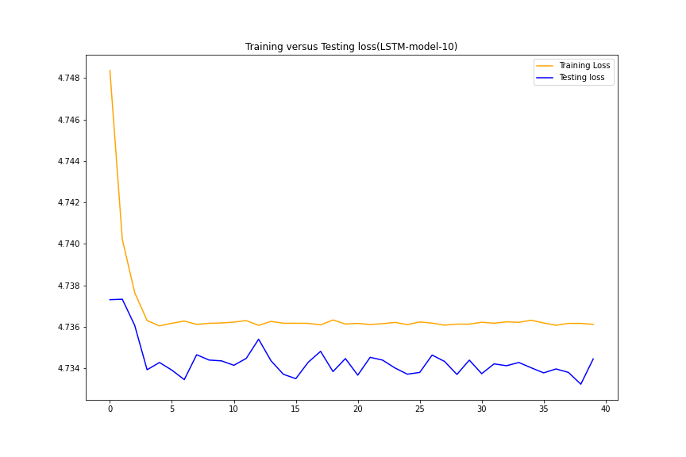

Slide 20

Conclusion
Best performing models: 4th Wavenet, and the 5th wavenet models. Gauged it by the val_loss.
Models were able to generate notes.
Generated compositions have a monotone quality to them

Slide 21

Next Steps
Need a midi editor to process files that have excess tracks with nothing in them.
LSTM architectures can be enhanced either by feeding it more data or adding encoder/decoder layers to improve model performance.

